Slide 1
Minor project- ai interviewer(modgenix-1)
Presented by:
Aayush Kumar Singh
Aman Uttam
Aishwary Dongre

Slide 2
Motivation
Any student aiming to practice interviews.
Huge amount of money required for a regular mock interview.
Replacement of human idealogy with a given corpus.
Students face a lot of barriers in interviews counting on if its a preliminary.

Slide 3
introduction
This project gives you an insight of your preparation for a given topic .
Any person appearing in the platform will be given a detailed report of his preparation.
Specialized and upgraded keyword matching algorithm that gives accuracy at a par.
After completion of this project , the expected outcomes are:
1-Keyword matching
2-Software testing
3-Basics of deep learning.

Slide 4
FEASIBILITY STUDY
TECHNICAL :-
This project requires extensive learning fields in order for the participant to test his/her language in their respective fields .
The part of our project uses many advanced concepts of fuzzy-wuzzy , tkinter and XLRD .
Any decent server with basic database system and python installed can handle the project smoothly.

Slide 5
Economic
Our Project will act as an open source design to help individuals shape their future and get their interviews planned out .
Our project will be available in software form and there is no hidden costs involved .
Operational
The user interface and user experience are designed for the ease of operation keeping in mind for non-technical person.
This project doesn’t require any complex system settings and processing will be done in background without letting the users know.

Slide 6
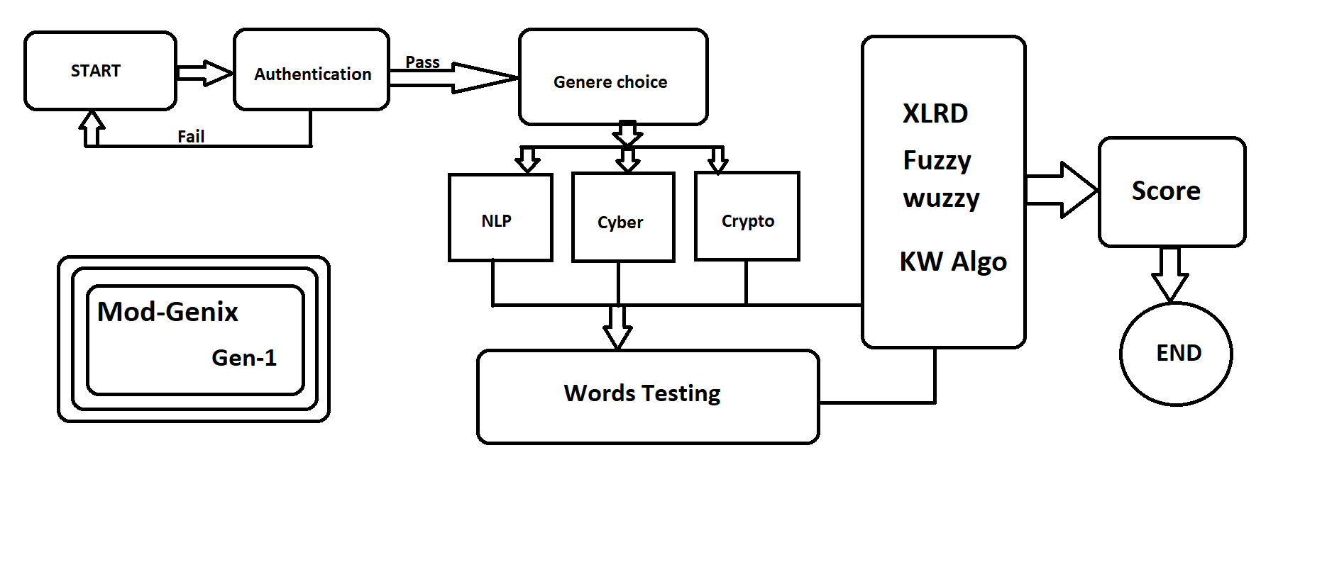
Flow diagram

Slide 7
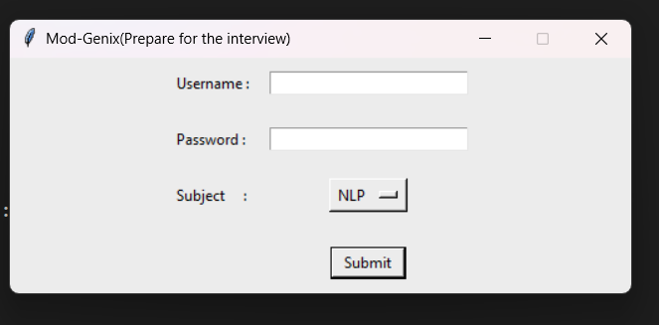
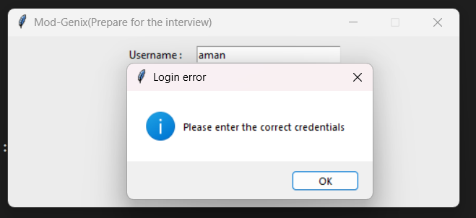
Results Obtained

Slide 8
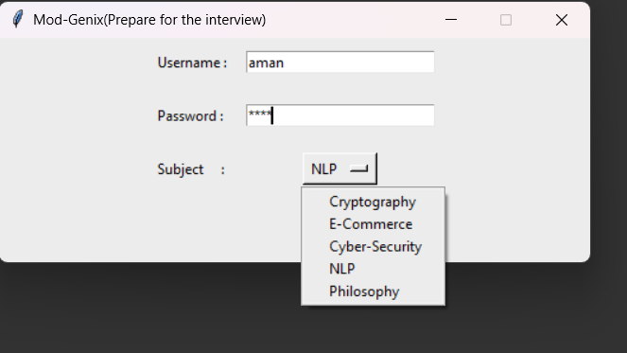
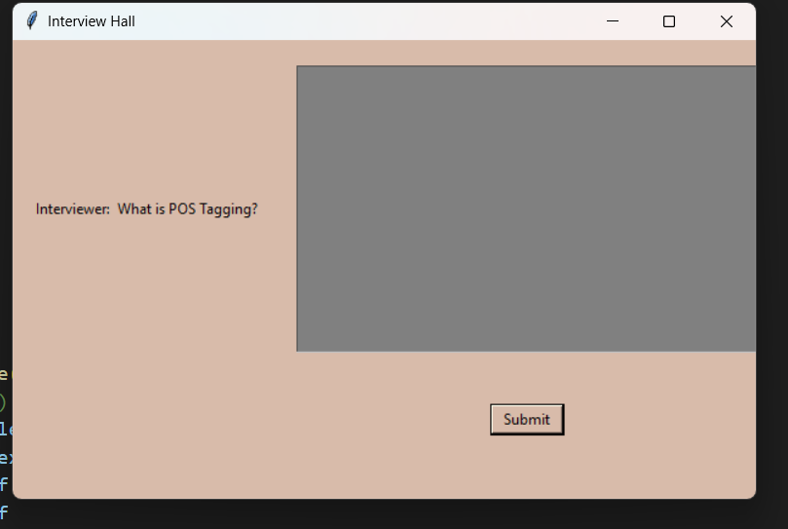

Slide 9
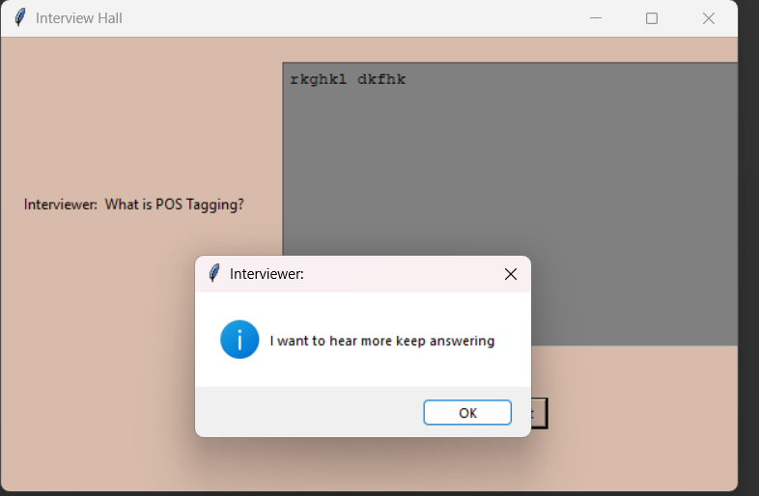
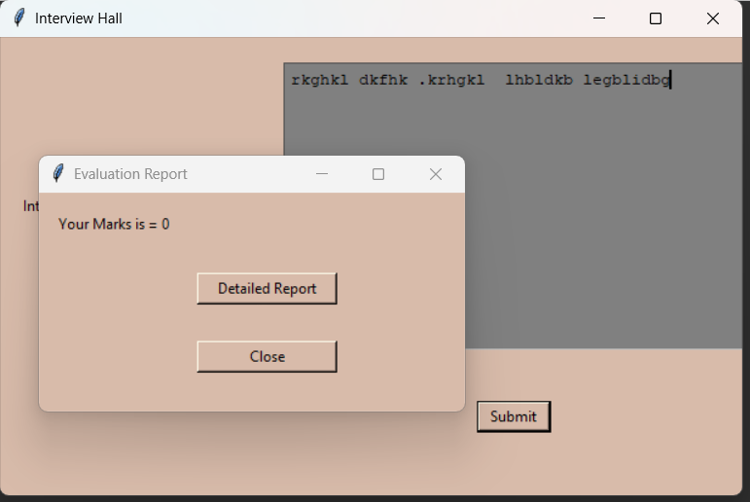

Slide 10
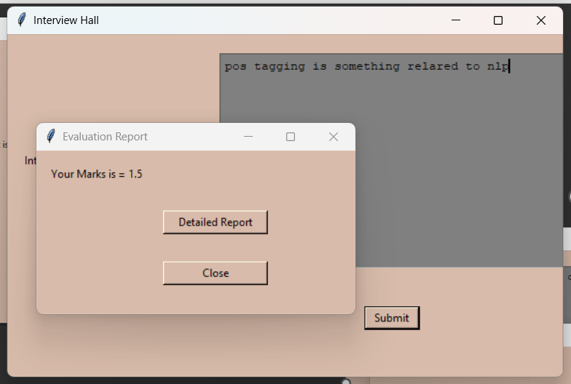

Slide 11
References
[1] Partha Sarathy Banerjee1 · Baisakhi Chakraborty1 · Deepak Tripathi2 · Hardik Gupta2 · Sourabh S. Kumar2,” A Information Retrieval Based on Question and Answering and NER for Unstructured Information Without Using SQL”,” Wireless Personal Communications (2019)”,PP:1911-1931.
[2] One-Match and All-Match Categories (OMAMC) for Keywords Matching in Chatbot Abbas Saliimi Lokman and Jasni Mohamad Zain Faculty of Computer Systems and Software Engineering, University Malaysia Pahang, Lebuhraya Tun Razak, 26300 Kuantan, Pahang, Malaysia
[3] AI Answer Verifier Sakshi Berad1, Pratiksha Jaybhaye2, Sakshi Jawale3 1,2,3Student, Comp Dept & Pune
International Research Journal of Engineering and Technology (IRJET) e-ISSN: 2395-0056

